Slide 1
Capstone Project-2
Appliance Energy Prediction Presented By: Sandeep R

Slide 2
Finding Appliance Energy Consumption
Exploring Dataset
Finding out Dependent and Independent variable[labeled data]
Exploratory Data analysis and Handling Null values
Finding Correlation between Features
Model building for predicting energy consumption by the Appliance
Perform Model tuning
Find the best Model

Slide 3
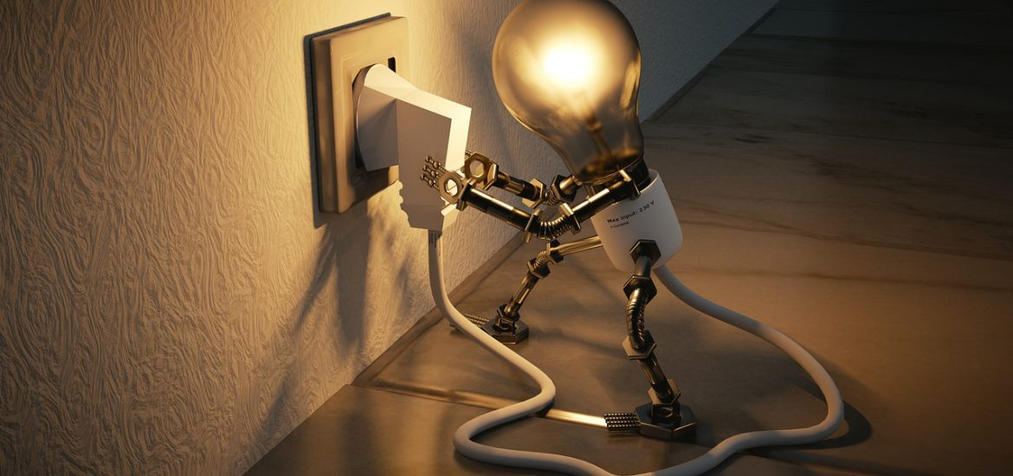
Brief Description of Dataset
The data set is at 10 min for about 4.5 months. The house temperature and humidity conditions were monitored with a ZigBee wireless sensor network. Each wireless node transmitted the temperature and humidity conditions around 3.3 min. Then, the wireless data was averaged for 10 minutes periods. The energy data was logged every 10 minutes with m-bus energy meters. Weather from the nearest airport weather station (Chievres Airport, Belgium) was downloaded from a public data set from Reliable Prognosis (rp5.ru) and merged together with the experimental data sets using the date and time column.

Slide 4
Independent Variables Dependent variables
T1 to T9 are variables which indicates temperature of different areas in home.
T_out is the Temperature outside (from Chievres weather station)
RH1 to RH9 are variables which indicates the humidity in different areas of home.
RHout, is the Humidity outside (from Chievres weather station)
Wind speed : Wind Speed (from Chievres weather station), in m/s
Visibility : Visibility(from Chievres weather station), in km
Tdewpoint: Tdewpoint (from Chievres weather station), Â°C
Appliances: Is the dependent variable which indicates the consumption of power in Kwh

Slide 5
Exploratory Data Analysis
Dataset Contains 19735 Examples and 25 Variables out of which 24 are Independent Variables and 1 of them is dependent variable.
Dataset doesn’t contain any null values
Temperature ranges for all home sensors is between 14.89℃ to 29.86℃ except for T6 for which it is -6.06℃ to 28.29℃. The reason for such low readings is that the sensor is kept outside.
Similarly, humidity ranges for all home sensors is between 20.60% to 63.36%. Except for RH_5 which is Bathroom humidity and RH_6 which is outside humidity, whose ranges are 29.82% to 96.32% and 1% to 99.9% respectively.
75% of the appliance consumption is between 10wh and 100wh

Slide 6
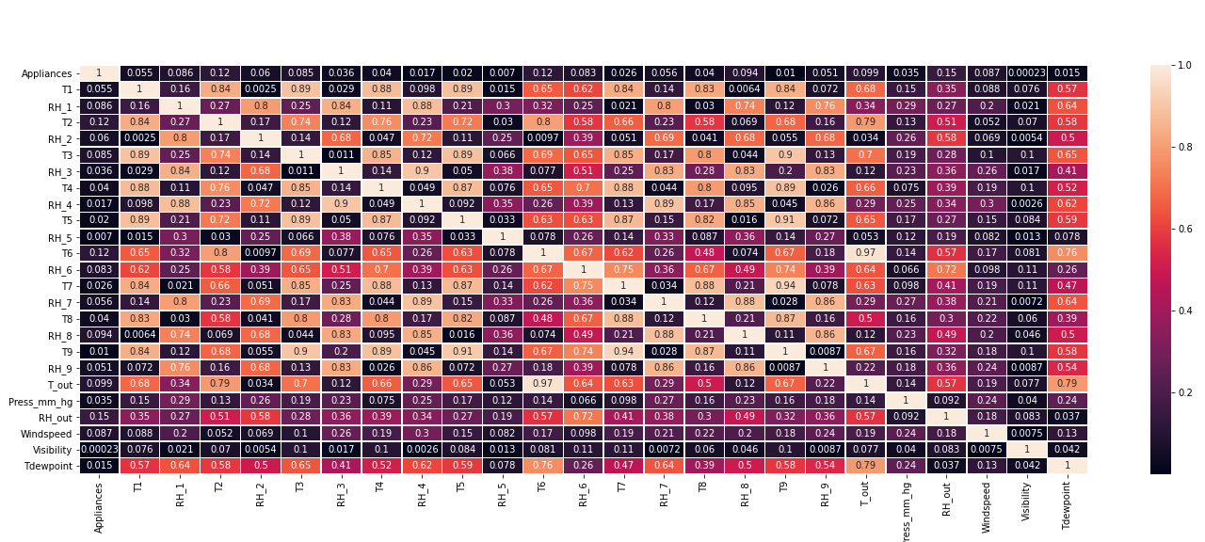
Correlation Between Variables

Slide 7
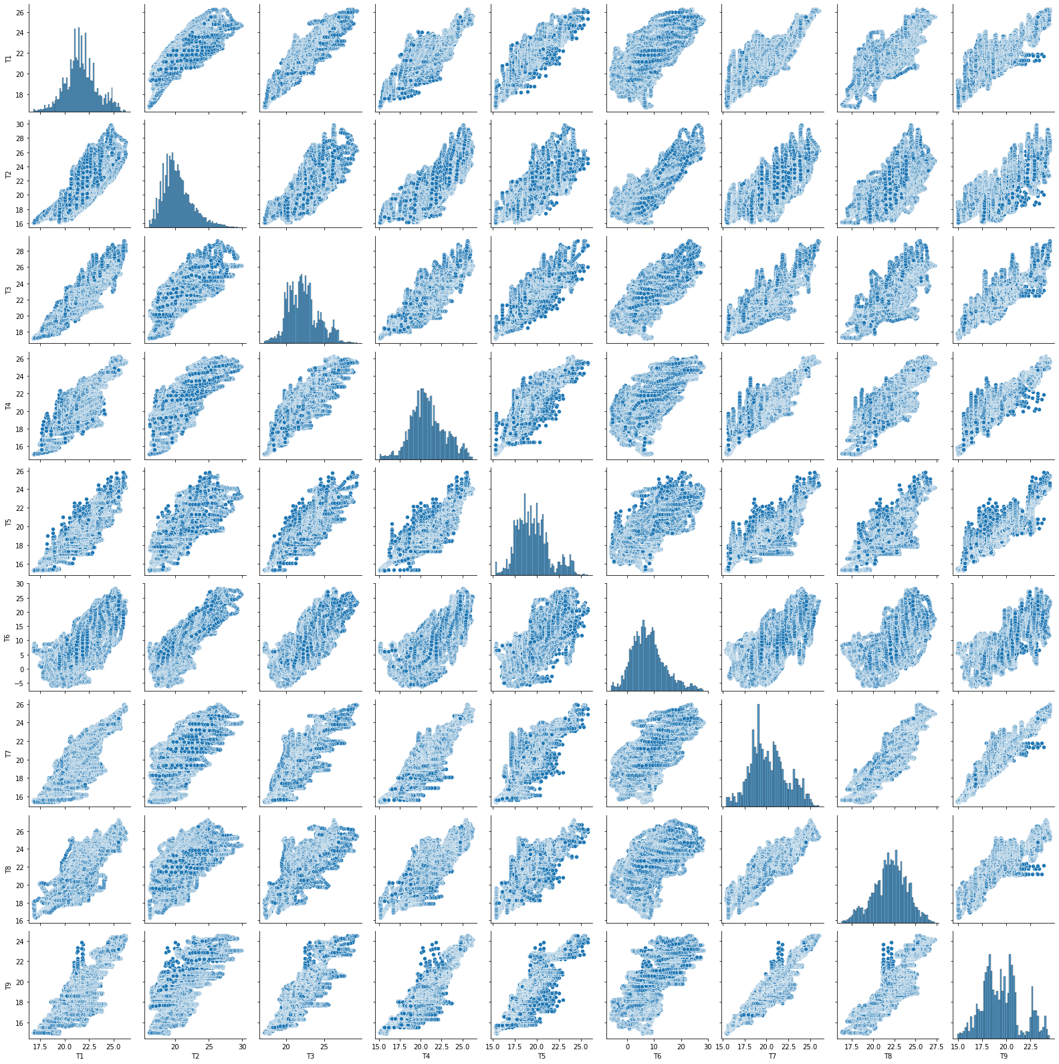
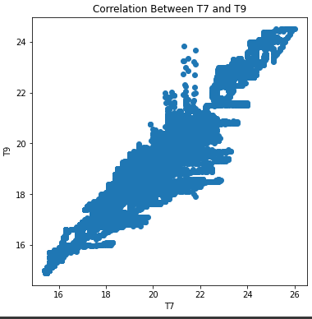
Correlation between temperature columns

Slide 8
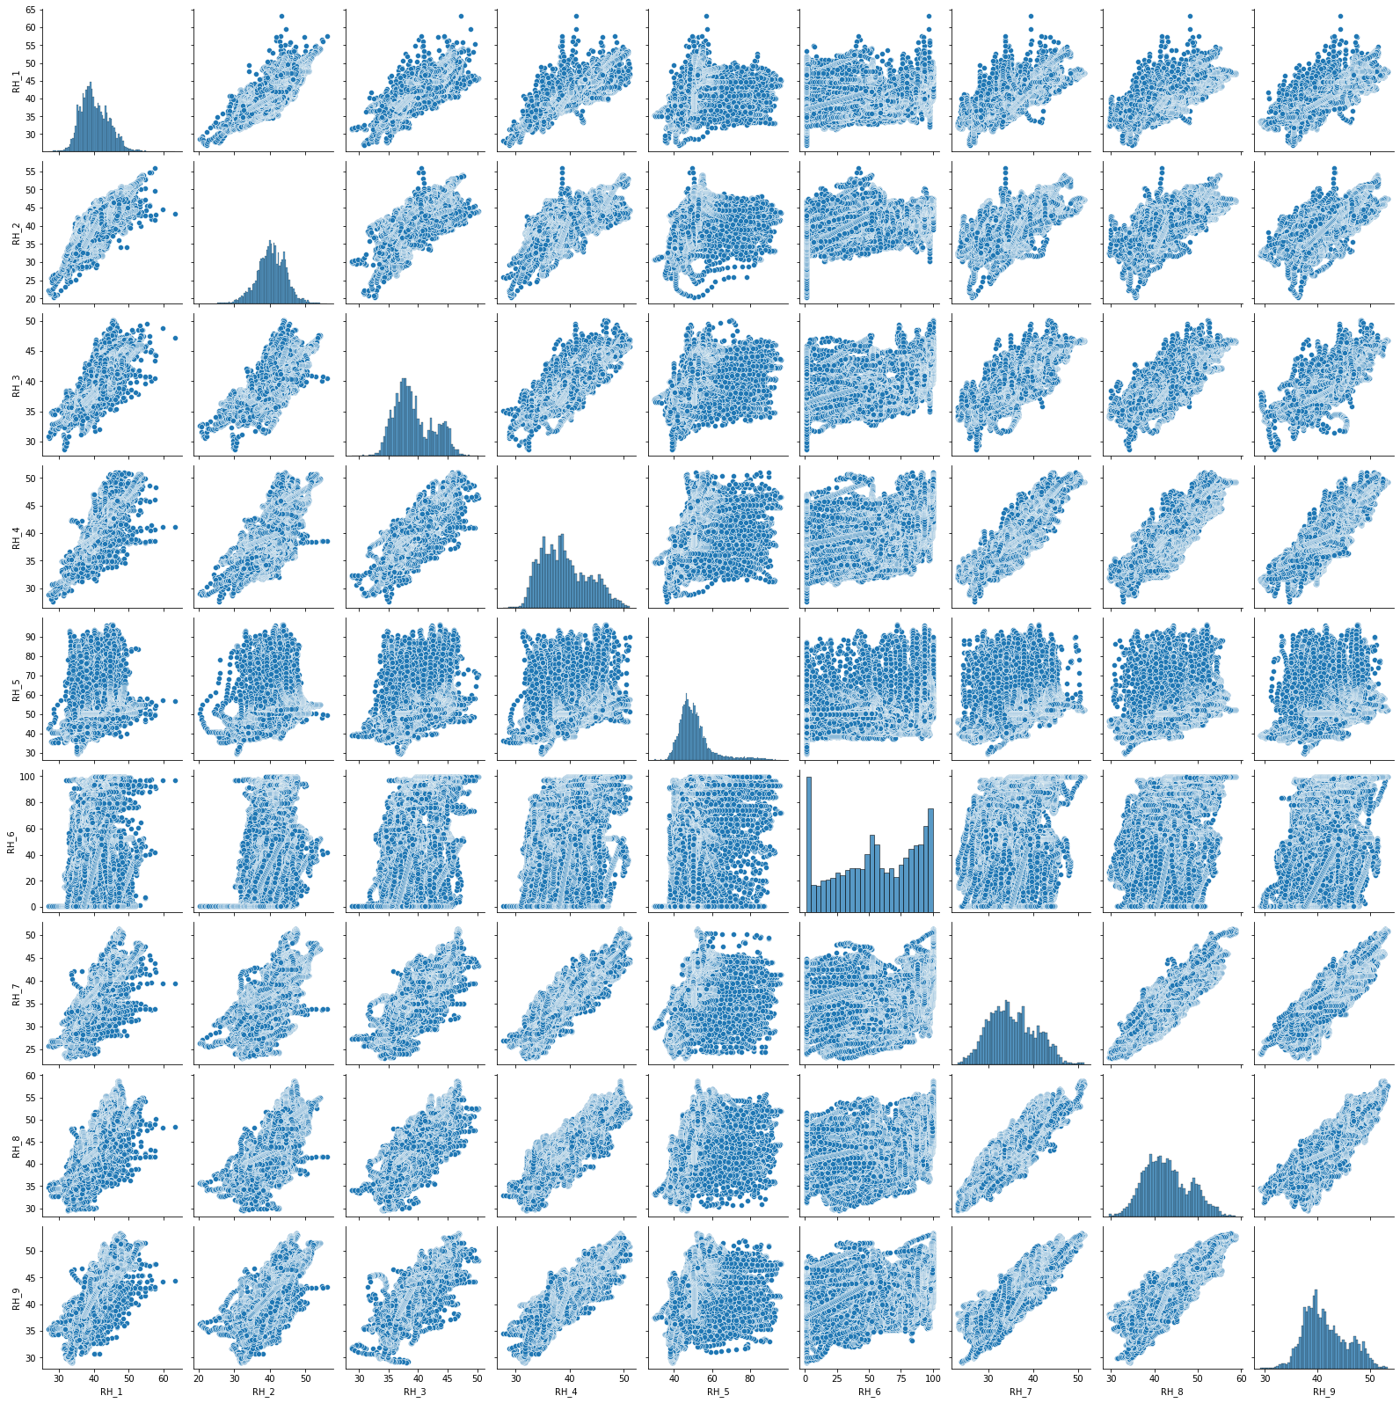
Correlation between Humidity columns

Slide 9
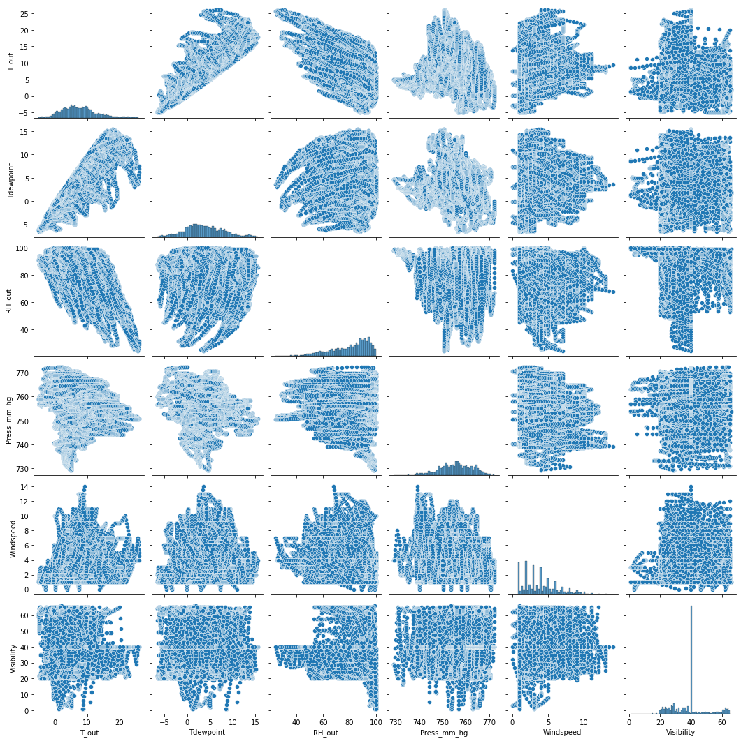
Correlation between Weather columns

Slide 10
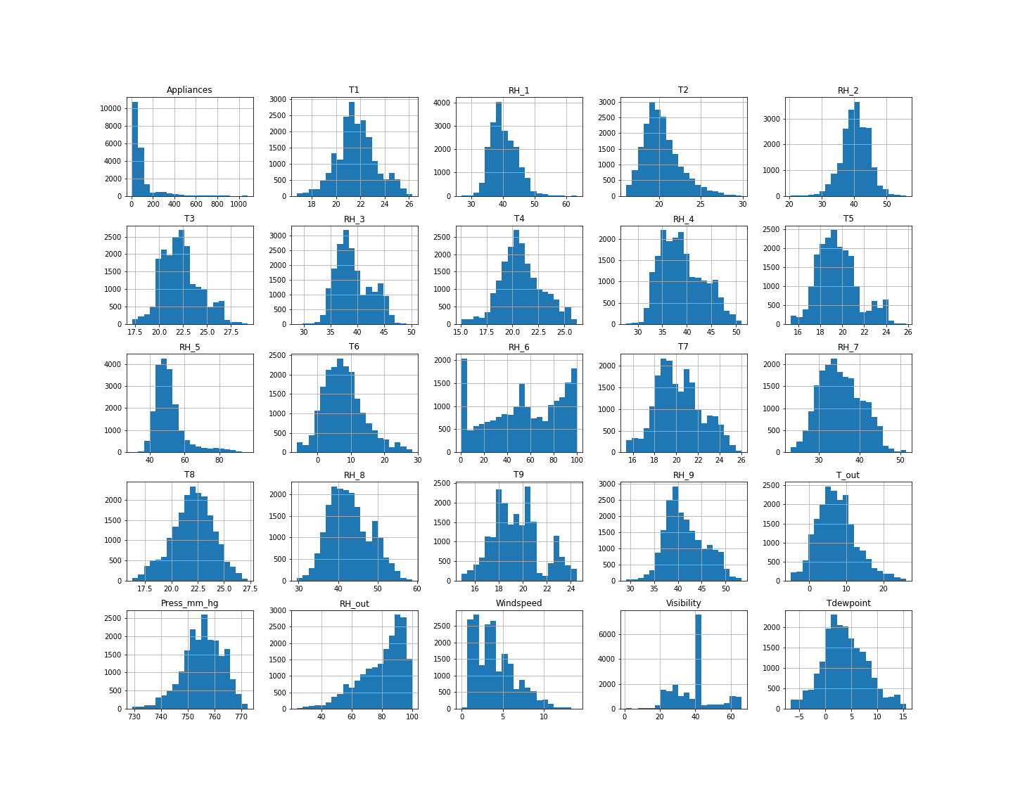
Distribution of Variables using Histogram

Slide 11
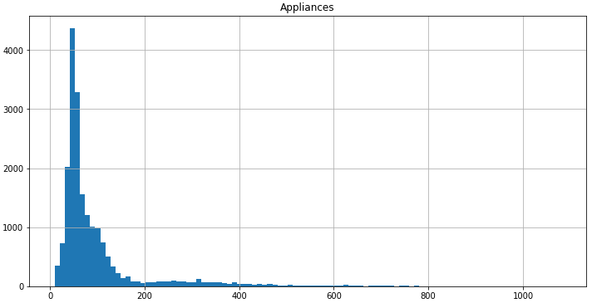
Dependent Variable[Target Variable]

Slide 12
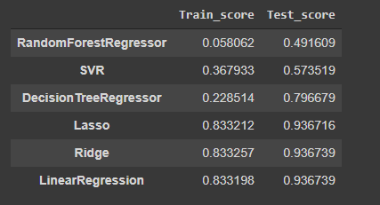
Model Selection

Slide 13
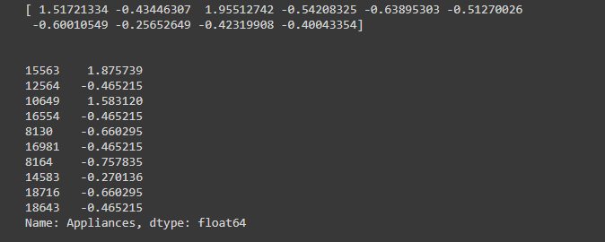
Predicted values of SVR

Slide 14
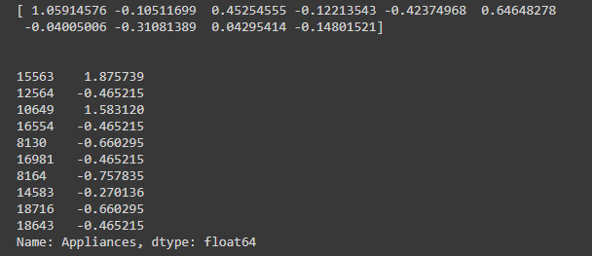
Predicted values of Linear Regression

Slide 15


Slide 16


